Slide 1




Aptech Computer Education - Aprotrain
VEHICLE INSURANCE MANAGEMENT WEBAPPLICATION ASP.NET MVC
KRAKEN FORCE
Advisor: Khiem Duy Bui
Class: C1908G1
Member:
+ Toan Ngo Vu Thanh
+ Long Ton That Thanh
+ Bao Le Hoang Phuc
+ Anh Dinh Van

Slide 2
I. Acknowledgements
In today’s world, the computer plays an important role in each field. It has been used in various fields. In the current age every aspect of our life has been influenced by information technology. The main aim of this project is to add some attraction and gild in record keeping operation of Vehicle Insurance..
We use the computer technology in many ways, from visible to invisible, spectacular to routine, video games and special effects, electronic cameras etc. The product entitled “automation” aim at automation of many processes of Vehicle Insurance. Current manual system that is employed is extremely laborious and quite inadequate, it only makes the process more difficult and hard. Main purpose of this software should be to reduce the manpower, paperwork and provide the security from unauthorized access. It should also help in producing difficult kinds of reports required for different managerial aspects.

Slide 3
II. Project Synopsis
The objective of the system is to provide the facilities to all the people concerned with Vehicle Insurance. From the management point of view works can be done fast and more accurately as compared to the existing manual system. From the customer’s point of view he can get immediate services without any kind of wasting of time whereas from the user’s point of view all kinds of transitions can be done in a very easy and efficient manner. The system also provides many kinds of reports generation facilities. Our main objectives for developing this project are giving below:
DATA SECURITY.
REDUCED PAPERWORK.
REDUCED MANPOWER.
INCREASED OPERATIONAL EFFICIENCY.
INCREASED ACCURACY AND RELIABILITY.
IMPROVE MORAL.
REDUCE OPERATIONAL TIME
The project is created by KrakenForce Team with 4 members

Slide 4
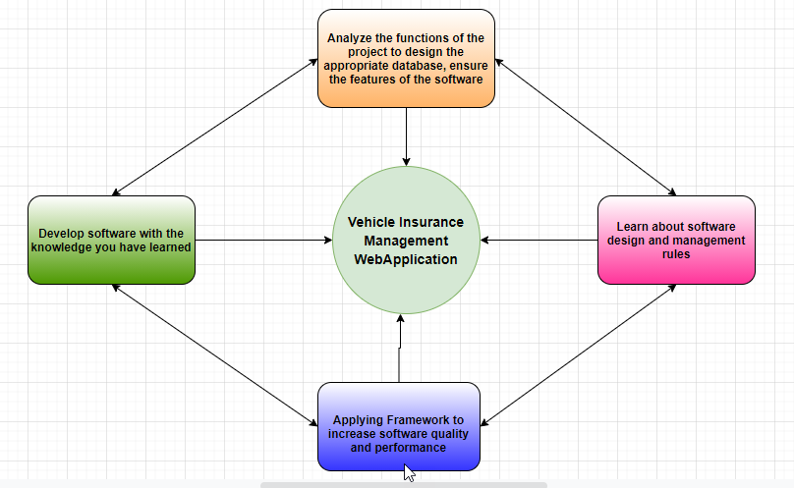
III. Project Analysis

Slide 5
IV. Project Design
1. DFD (Data Flow Diagram)
2. Flowcharts
3. Process Diagram
4. Database Design/ Structure

Slide 6
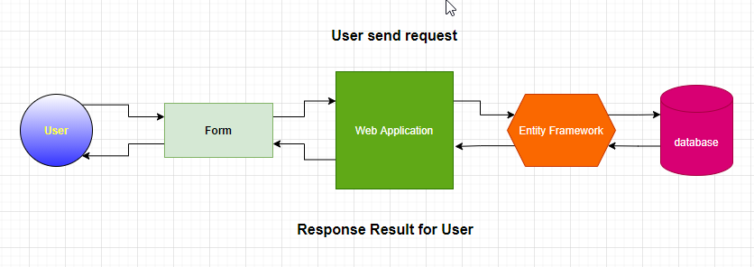
1. DFD (Data Flow Diagram)

Slide 7
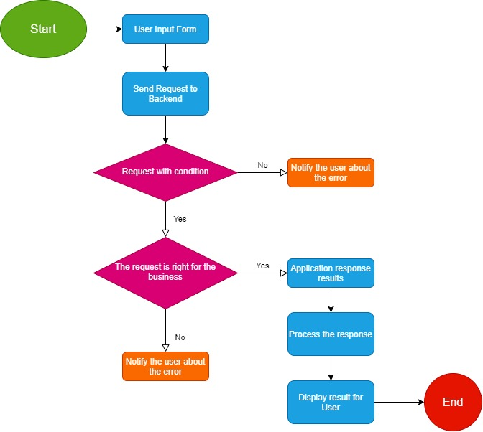
2.Flow Chart

Slide 8
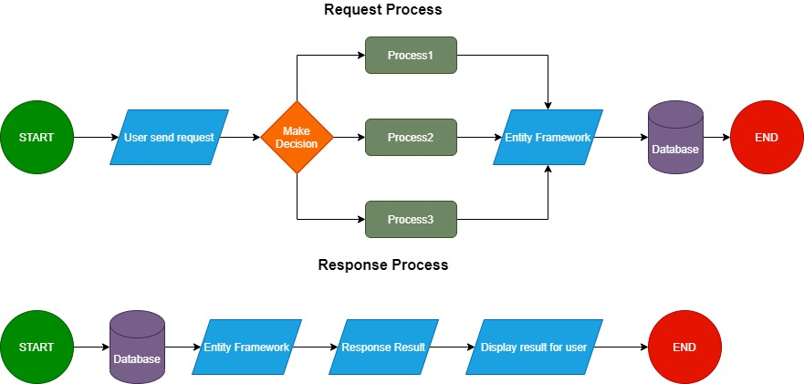
3. Process Diagram

Slide 9
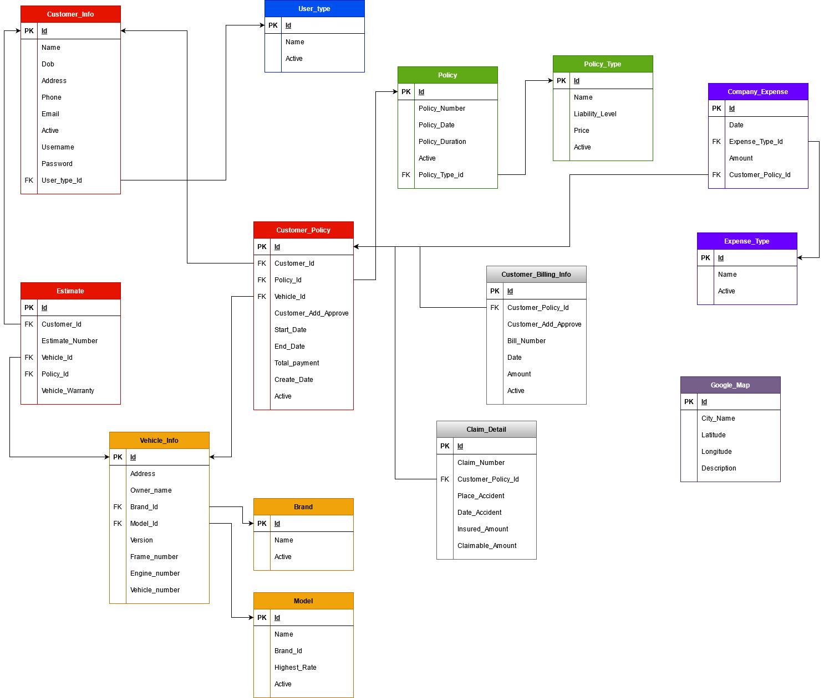
4. Database Design / Structure
Detail Info: Vehicle_Insurance_Feature

Slide 10
V. Screenshot
1. Authentication Module
2. Client Page
3. Customer Manage Module
4. Vehicle Manage Module
5. Insurance Buy
6. Customer Policy Manage
7. Customer Policy Bill Module
8. Report
9. Company Expense Manage
10.Claim Detail Manage

Slide 11
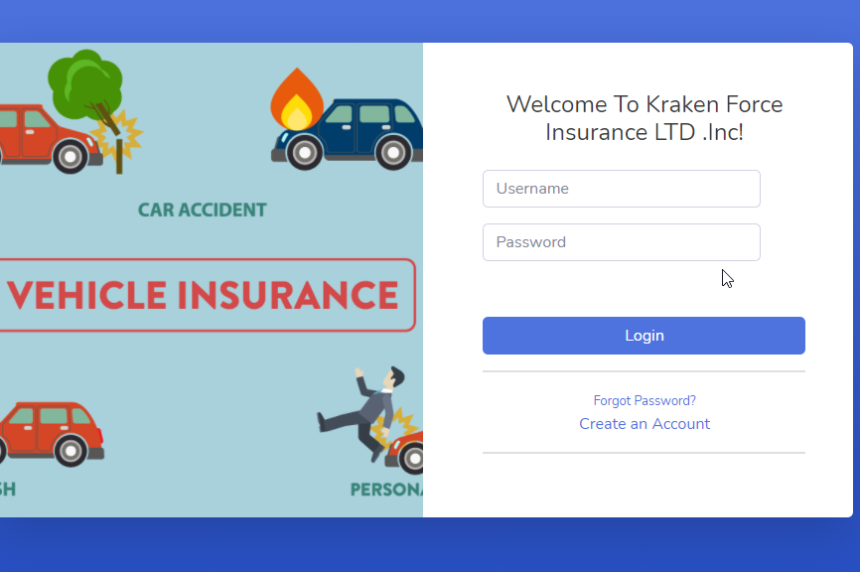
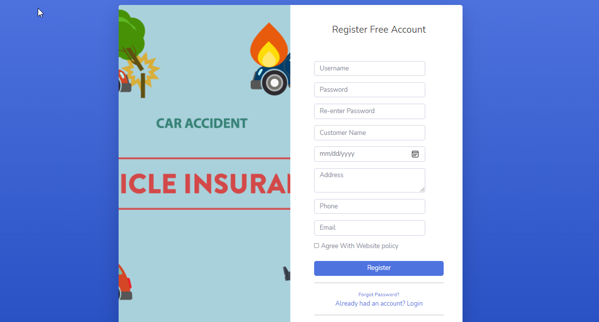
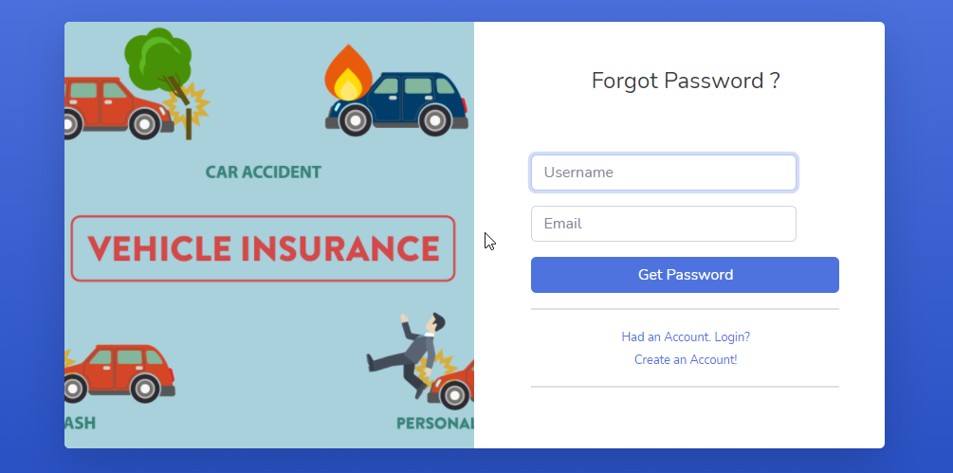
1. Authentication Module

Slide 12
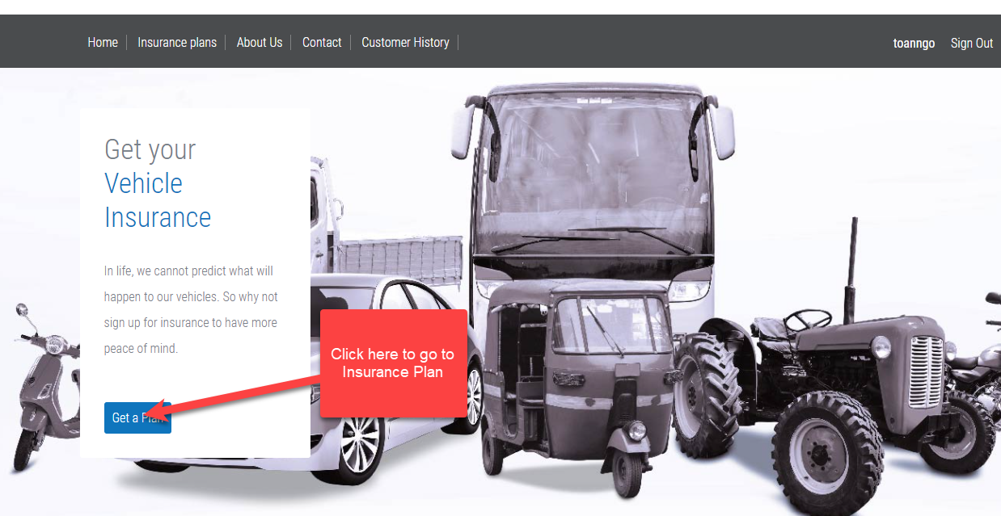
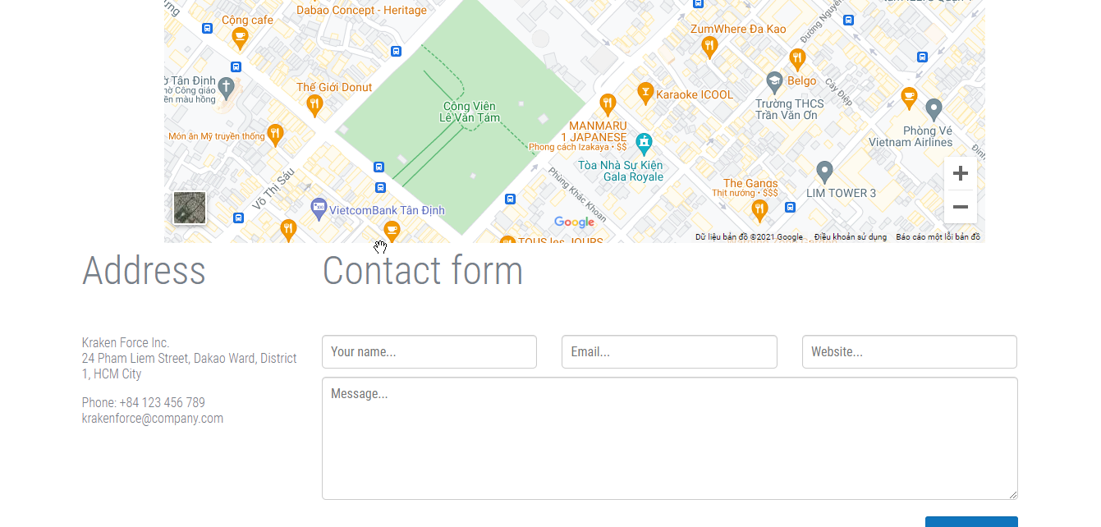
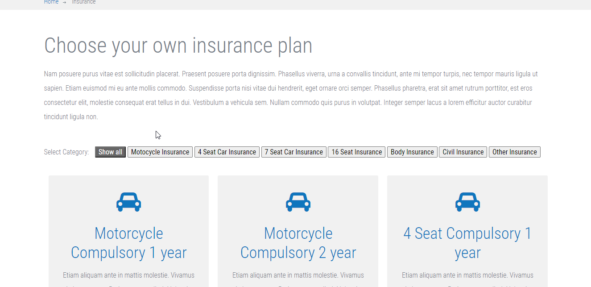
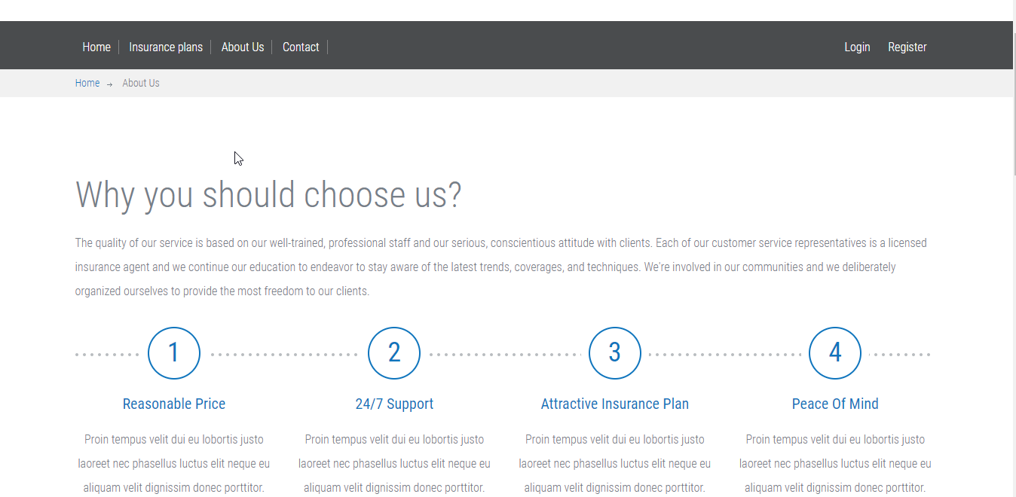
2.Client Pages

Slide 13
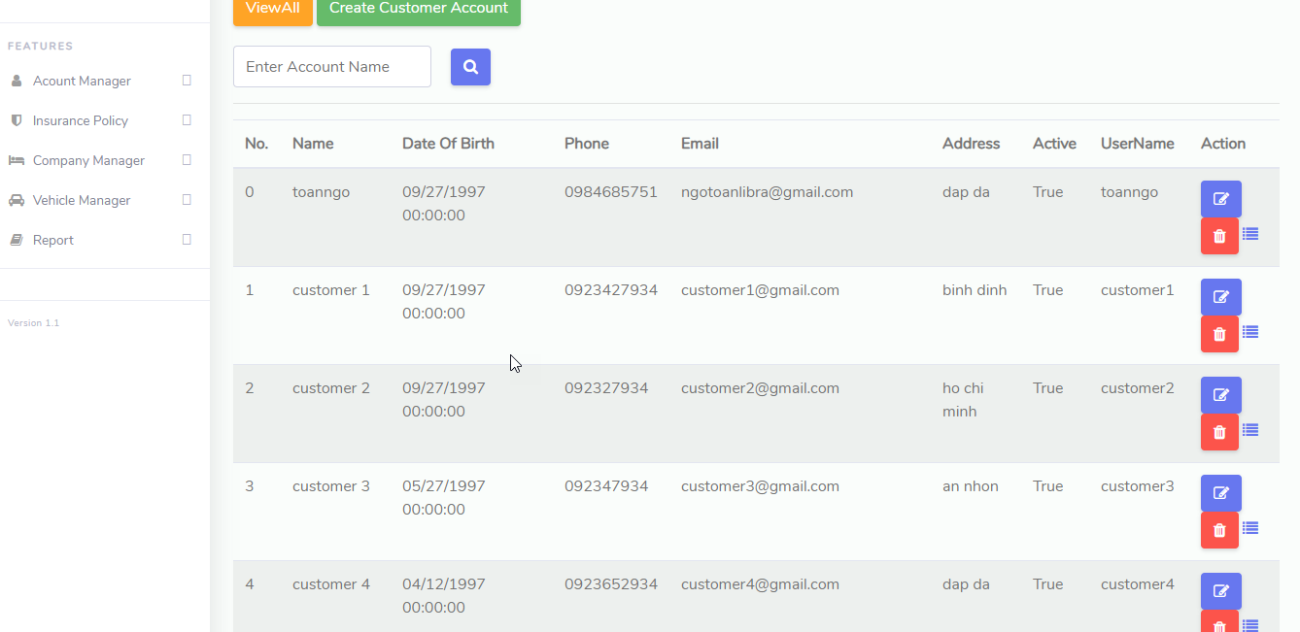
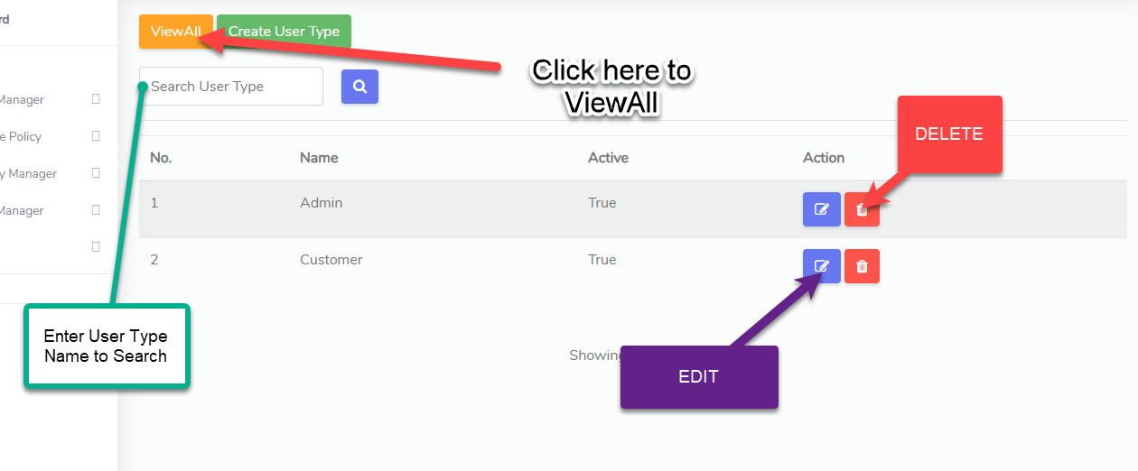
3. Customer Manage

Slide 14
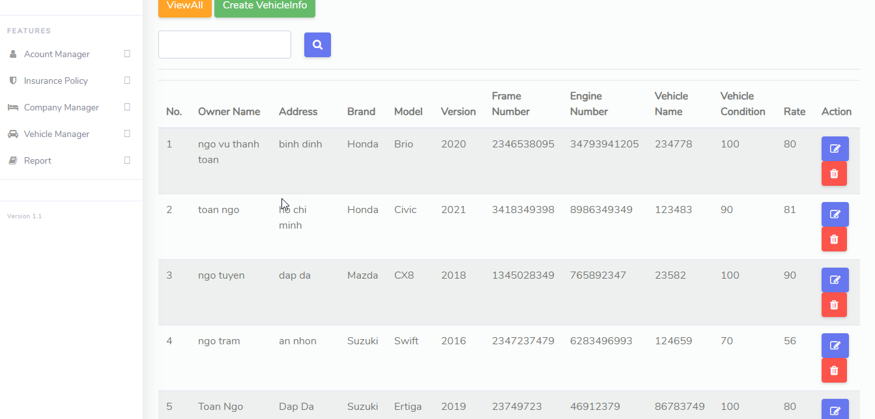
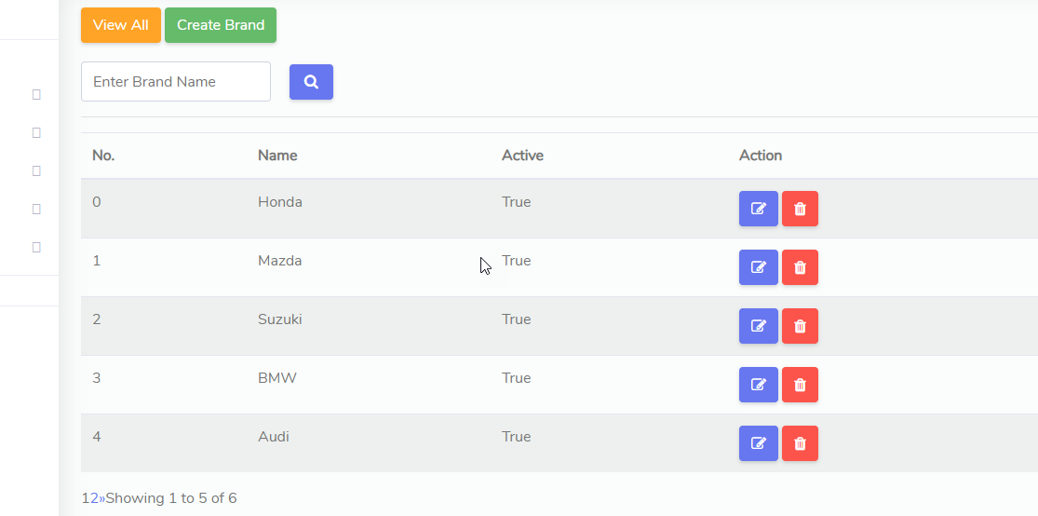
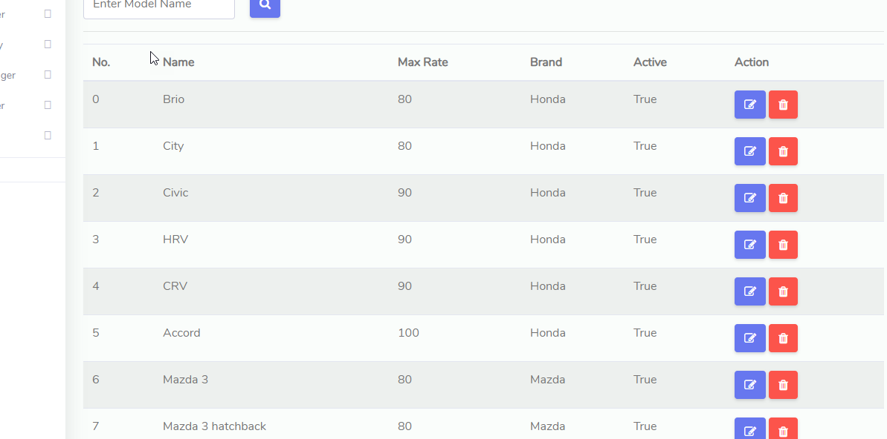
4. Vehicle Manage

Slide 15
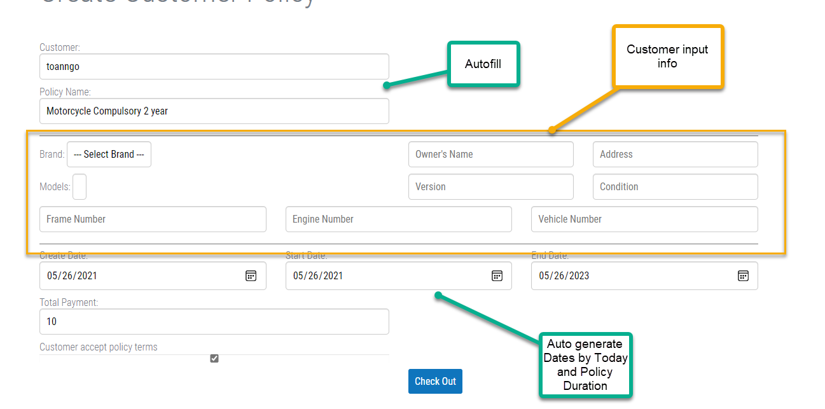
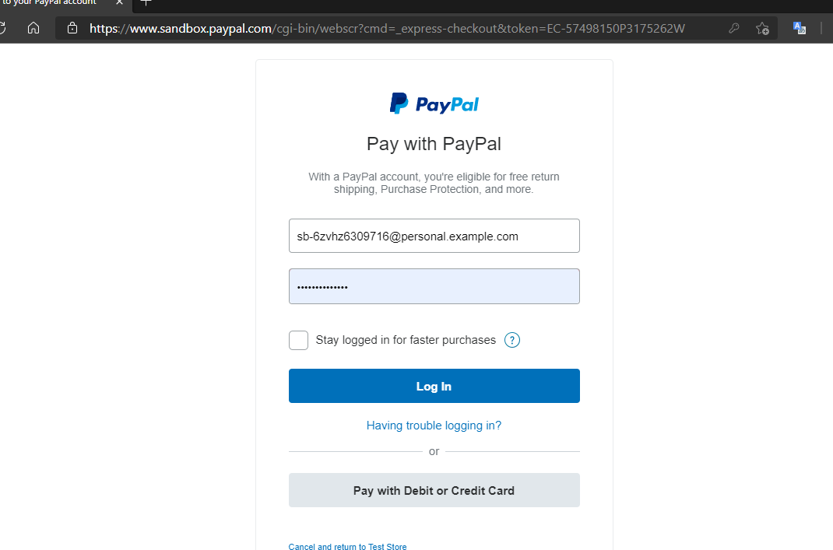
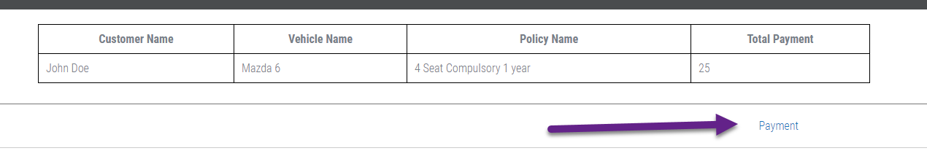
5.Insurance Buy

Slide 16
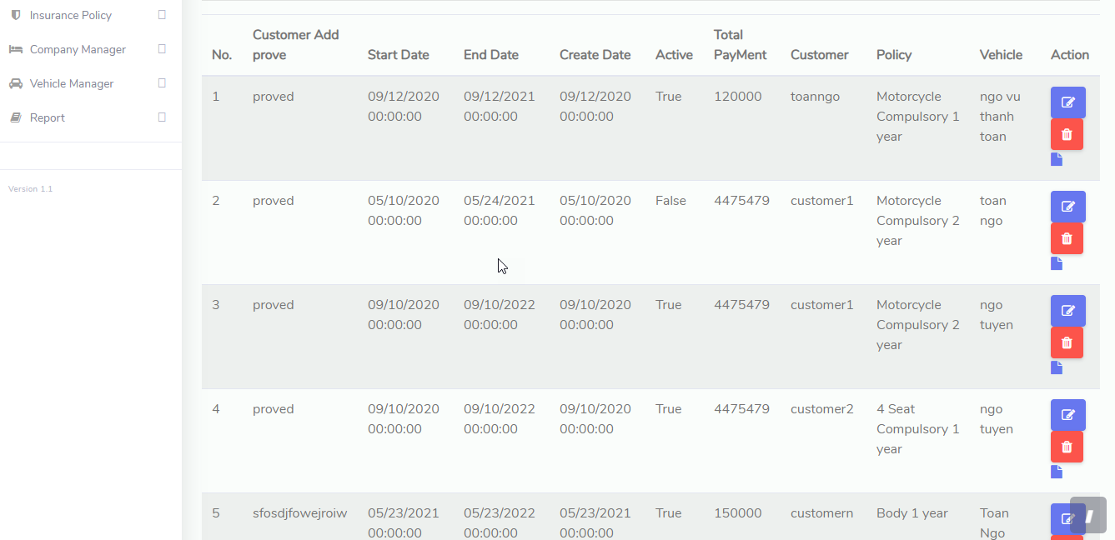
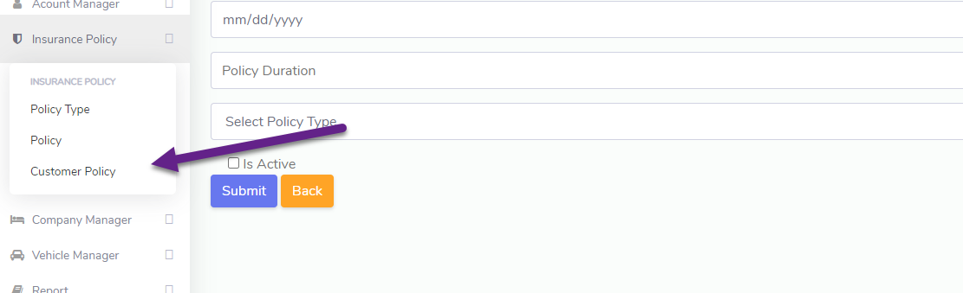
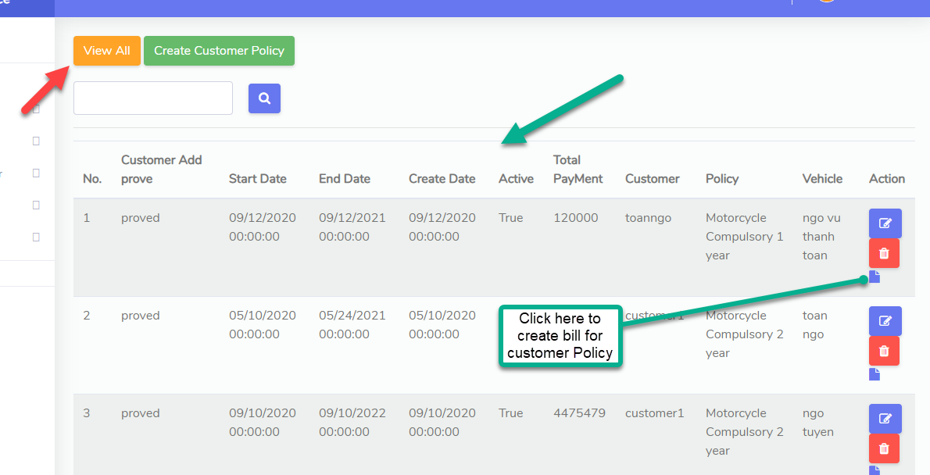
6. Customer Policy Manage

Slide 17
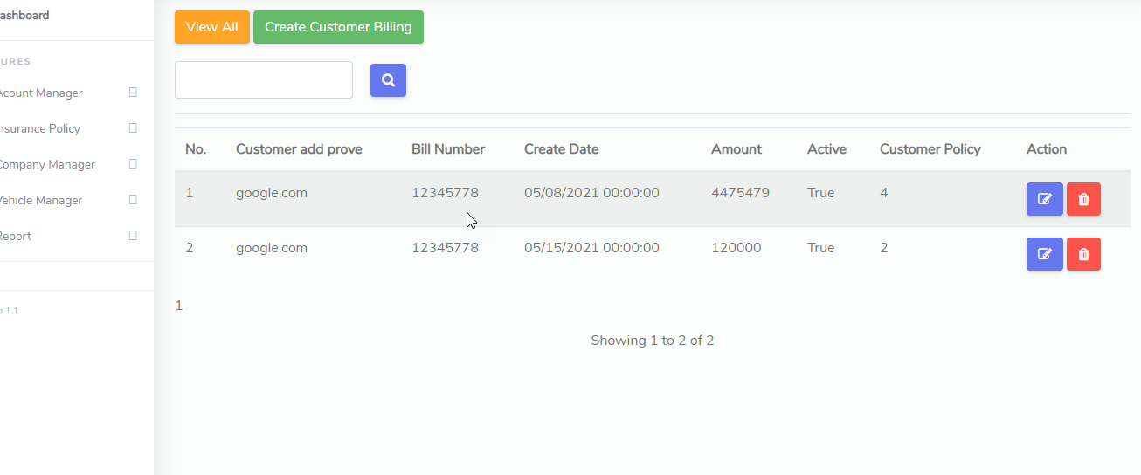
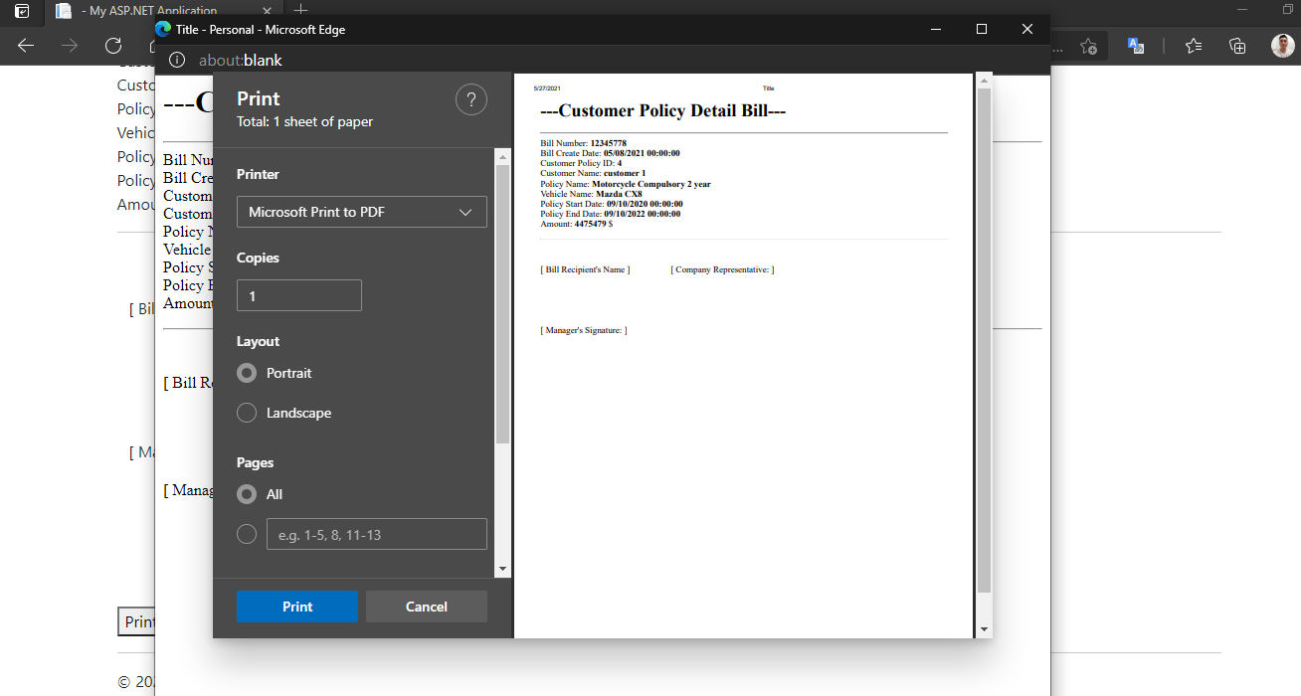
7. Customer Policy Bill

Slide 18
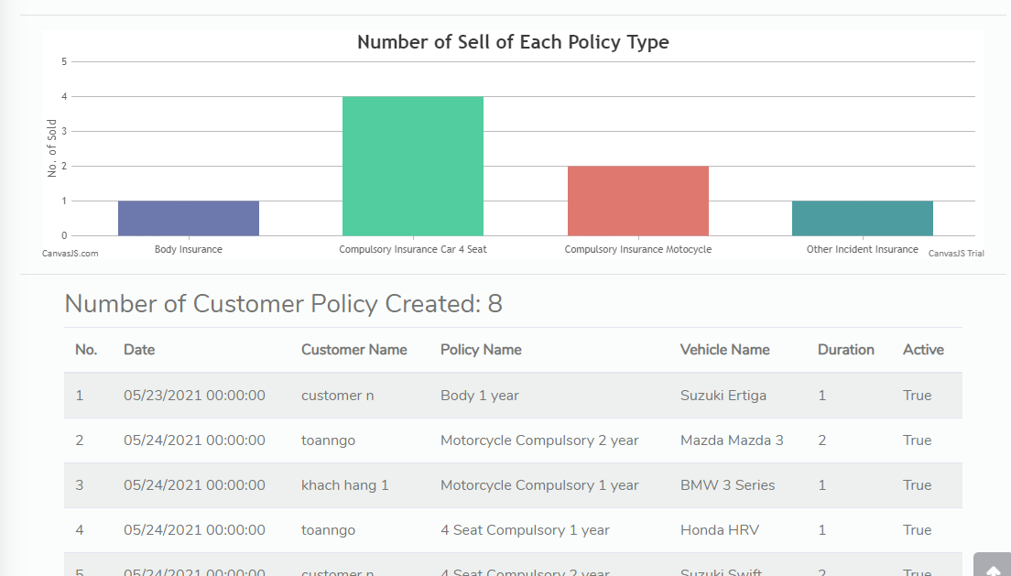
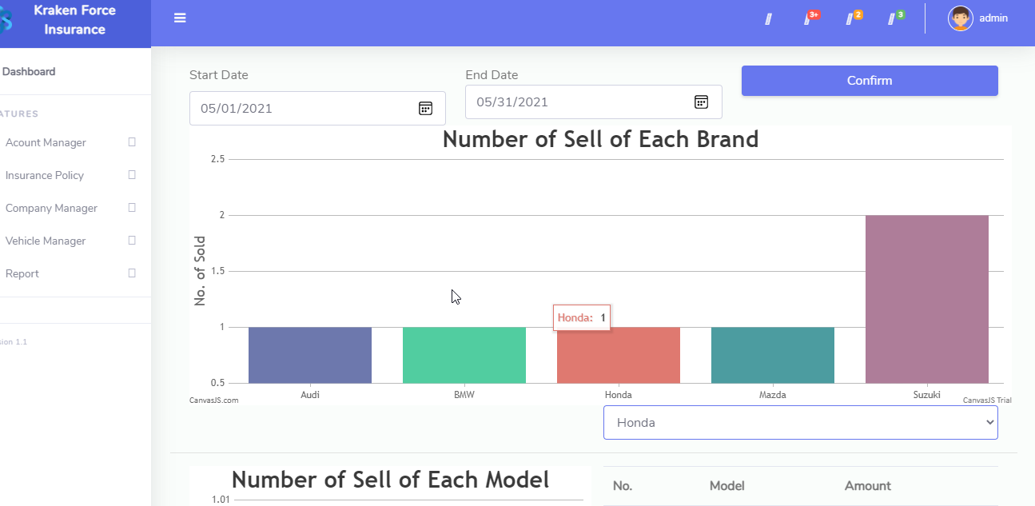
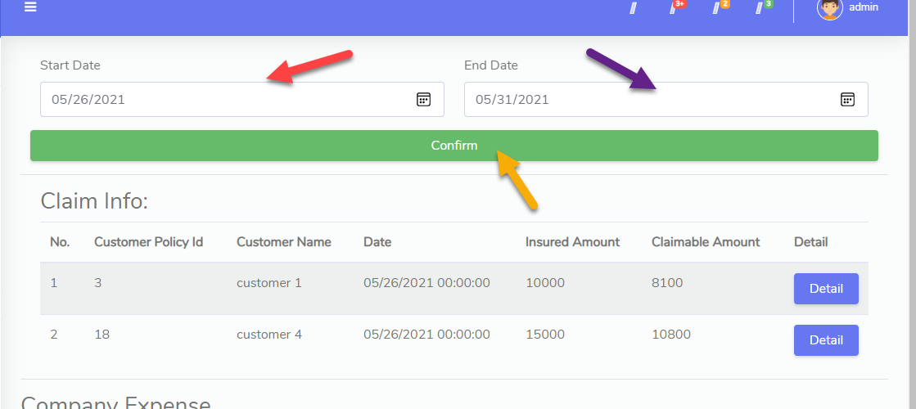
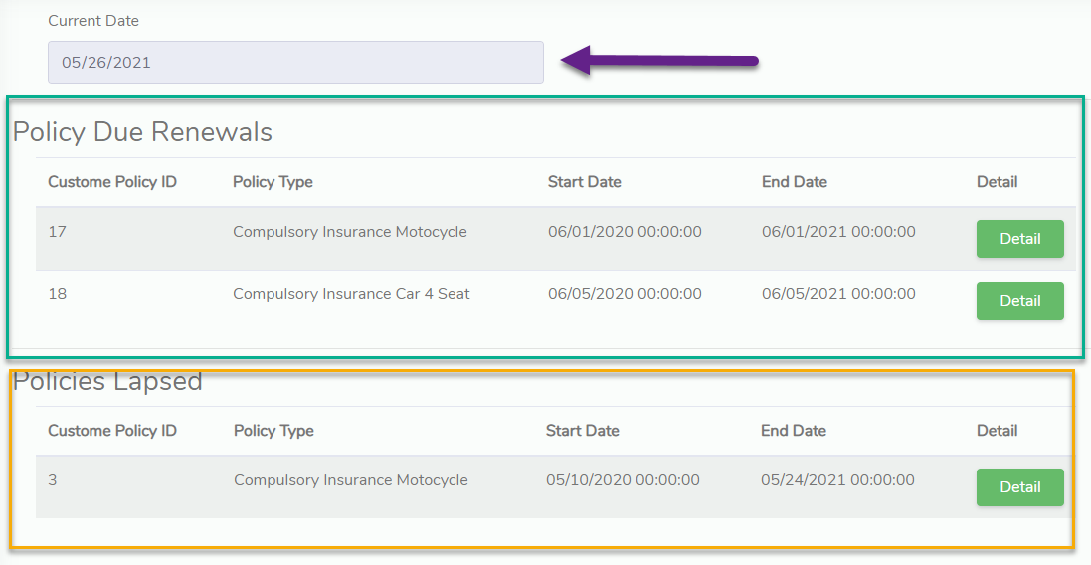
8.Report

Slide 19
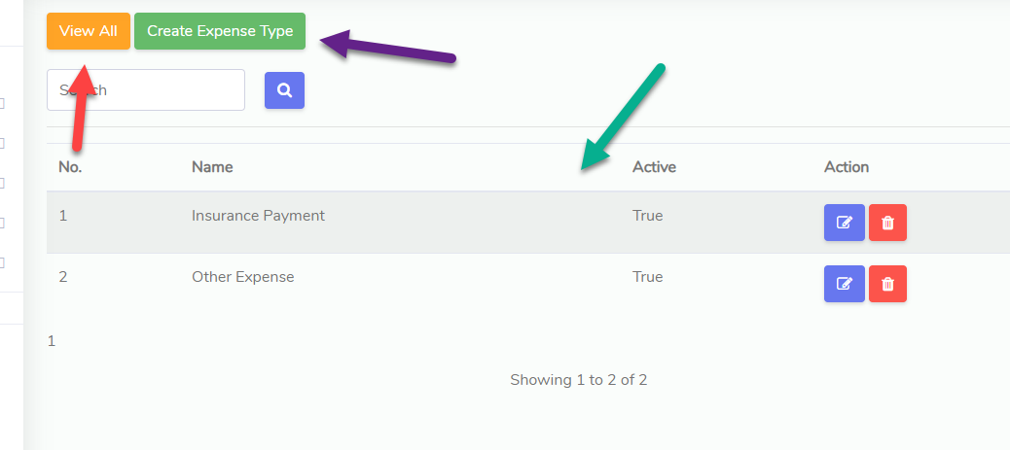
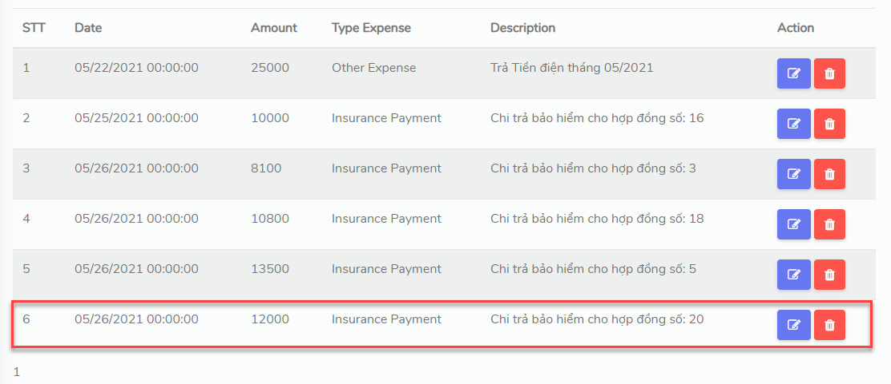
9. Company Expense

Slide 20
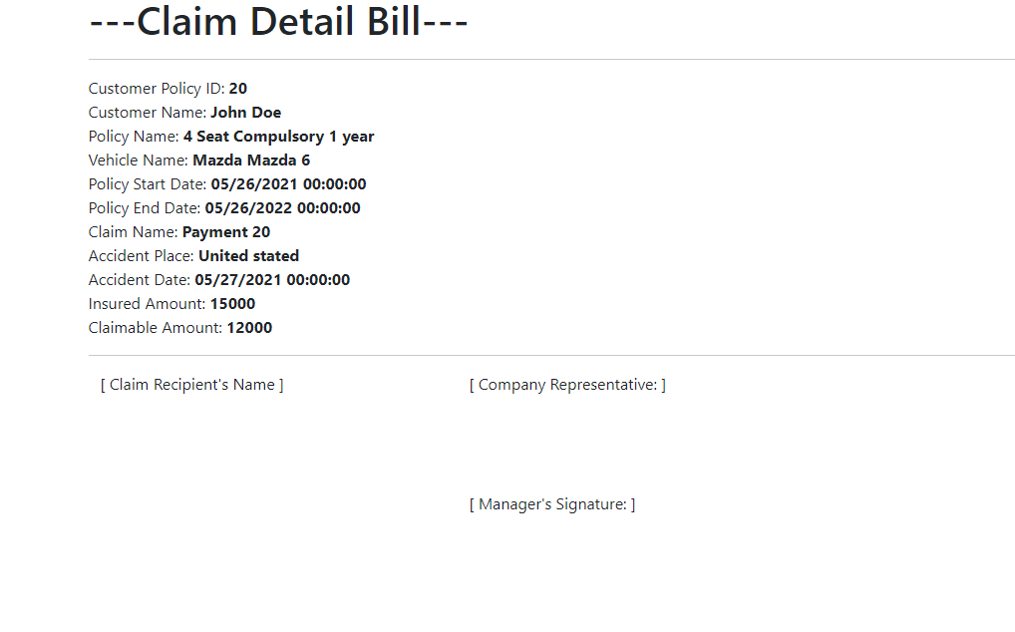
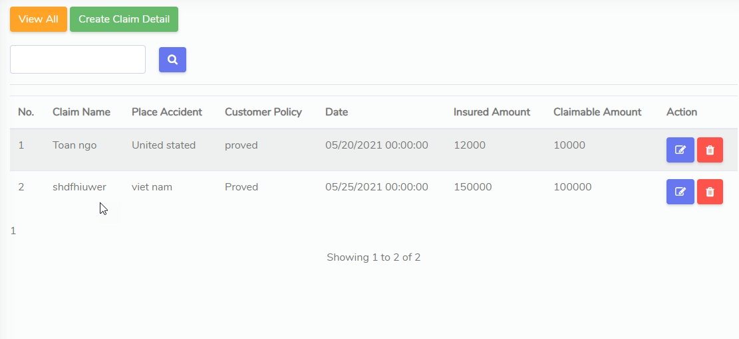
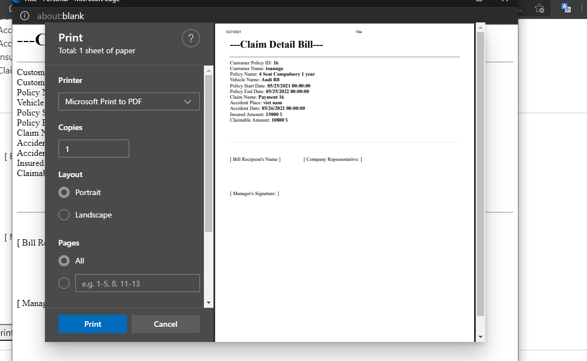
10.Claim Detail

Slide 21
Thank you for coming to our presentation today

